Slide 1
Word classes
Remind your partner of the following: noun, adjective, verb and adverb

Slide 2
Nouns
A person, place or thing
However, there are types of noun . . .
Proper nouns are names of a particular person, place or thing or the day/month - These must have capital letters
For example: John, London, Monday, December, Spain

Slide 3
Nouns
Abstract Nouns a feeling or concept that cannot be touched such as love and happiness.
Task: Can you think of 5 other abstract nouns?
Collective nouns refer to a group of people, animals or things.
For example: class, herd, pride
Task: Match these animals to their collective noun
Crows Flock
Sheep Parliament
Owls Shoal
Fish Murder

Slide 4
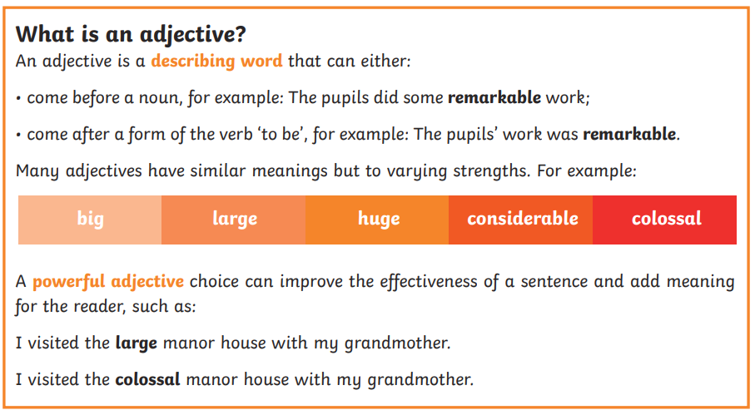
Adjectives - describe NOUNS

Slide 5
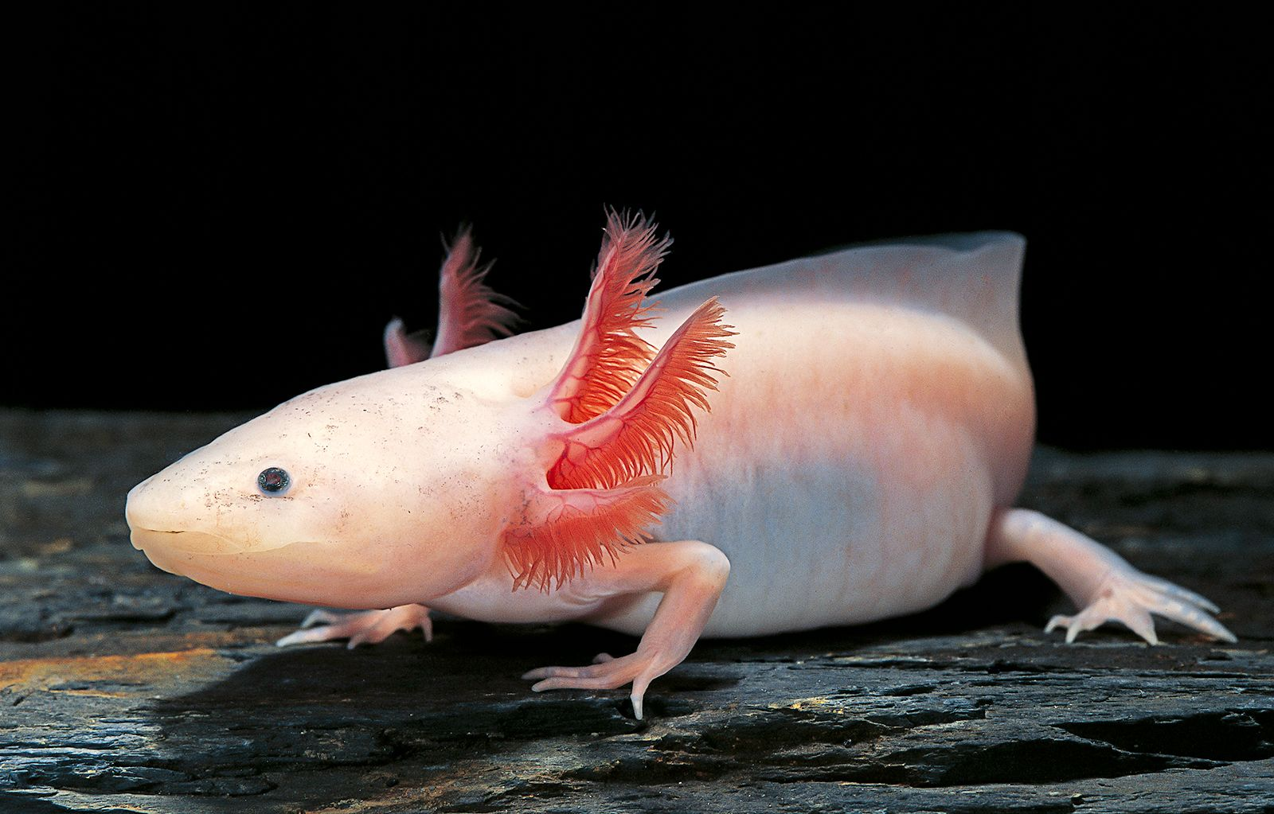
Task
What adjectives could we use to describe the animal below?

Slide 6
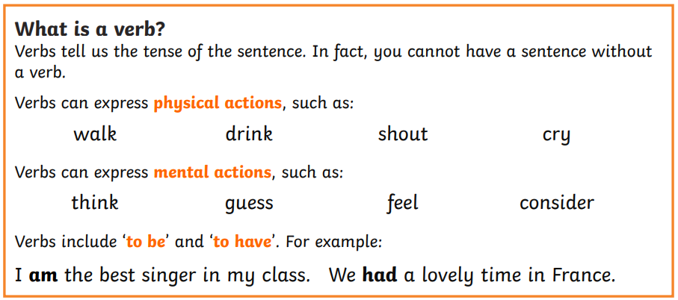
Verbs

Slide 7
Verbs - task
On your whiteboards, write 5 verbs that we would do in school
On your whiteboards, write 5 verbs that we would see or do at a football game.

Slide 8
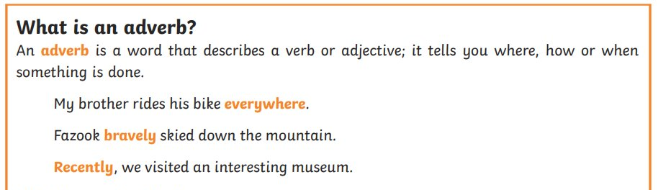
Adverbs – describe verbs
Adverbs describe HOW things are done.
Yes it is a lot of 'ly' ending words but not all
It includes time such as 'often' and 'soon'

Slide 9
What adverbs could fill the missing gaps in the sentences below?
James was walking _____________ to make sure he wasn’t late for the dentist.
Your parents will arrive ____________.
________, they crept into the hallway.

Slide 10
Questions
In the sentence below, what is the word class of the word in bold?
The ancient castle stood on the hill.
a) Noun
b) Verb
c) Adjective
d) Adverb
HINT – find the noun and the verb

Slide 11
Questions
What is the word class of watch in this sentence?
I need to watch the baby.
a) Noun
b) Verb
c) Adjective
d) Adverb
HINT – find the noun and the verb

Slide 12
Questions
What is the word class of light in this sentence?
This bag feels light.
a) Noun
b) Verb
c) Adjective
d) Adverb
HINT – find the noun and the verb

Slide 13
Independent task
Stick the sheet in
Complete it
Get it marked
Move onto practise SATS questions

