Slide 1
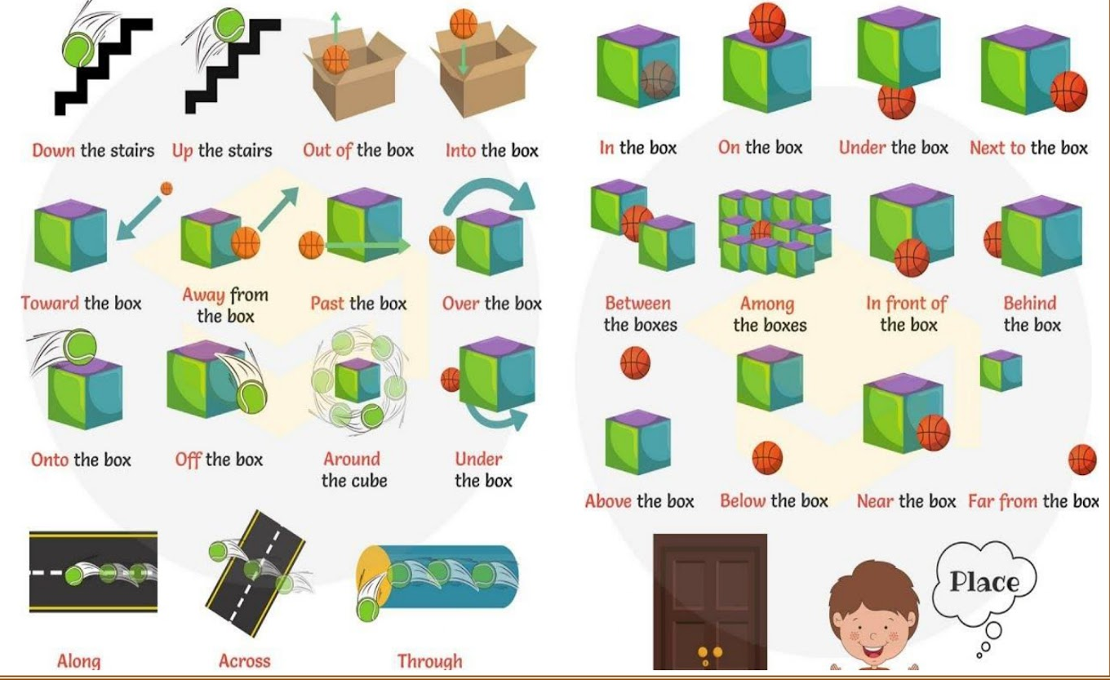
Prepositions

Slide 2
Prepositions
Prepositions tell us where or when something is in relation to something else.
Remember the word POSITION in preposition
The cat is under the table.
We will meet after school.
She walked across the road.
The book is on the shelf.

Slide 3
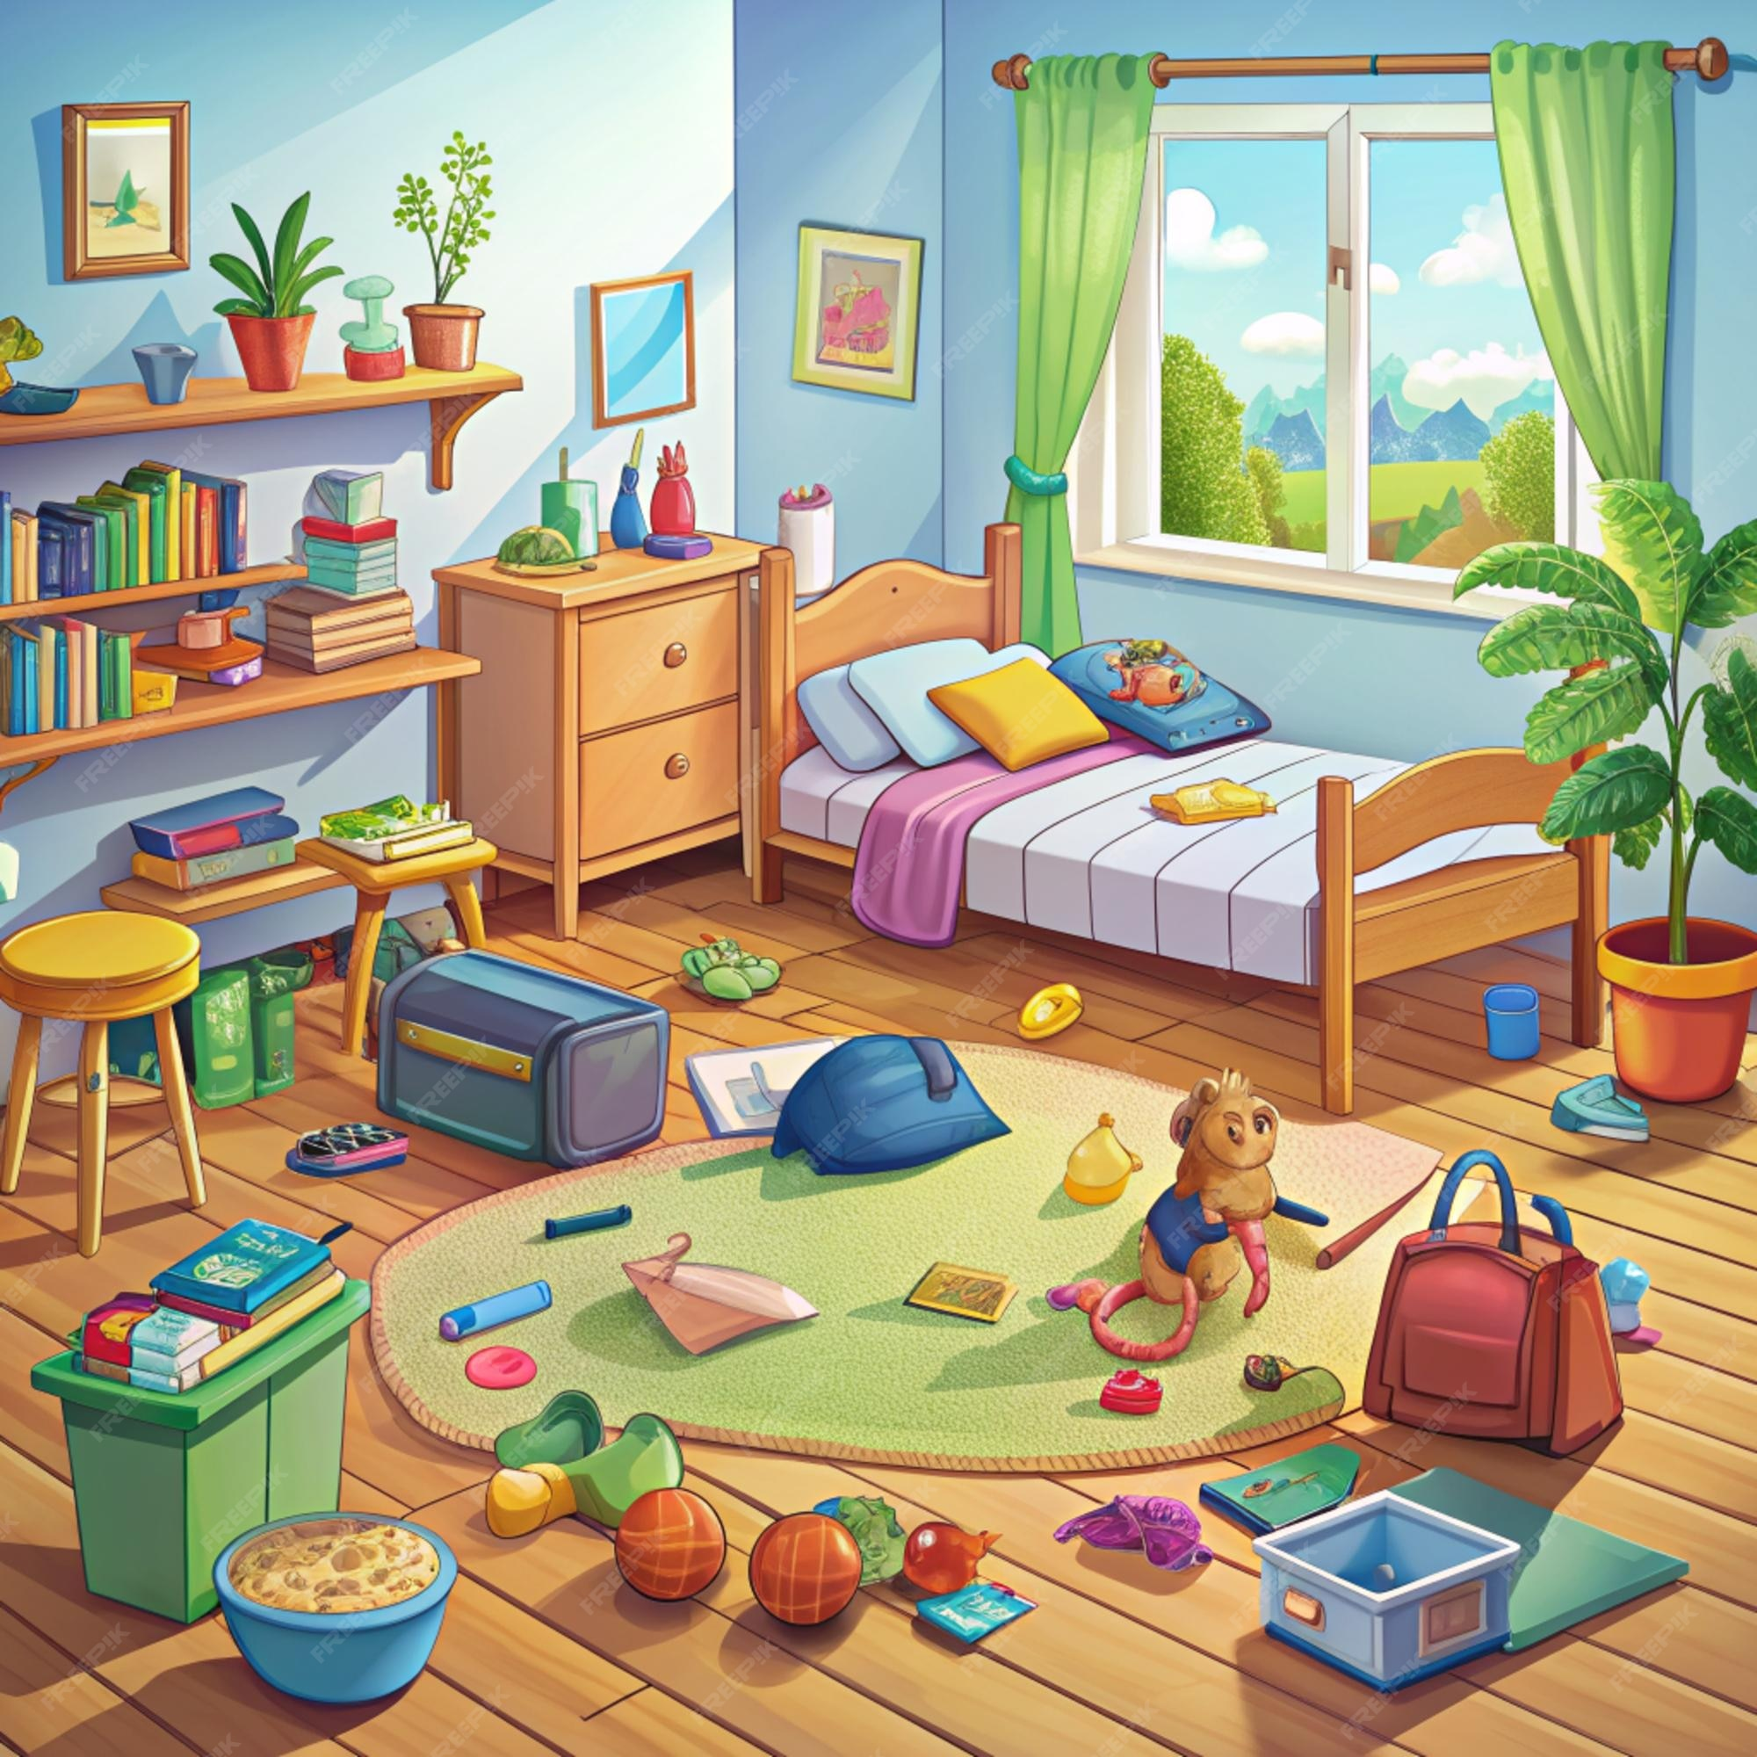
Tell me some sentences containing prepositions about this room
The pillows are on the bed.

Slide 4
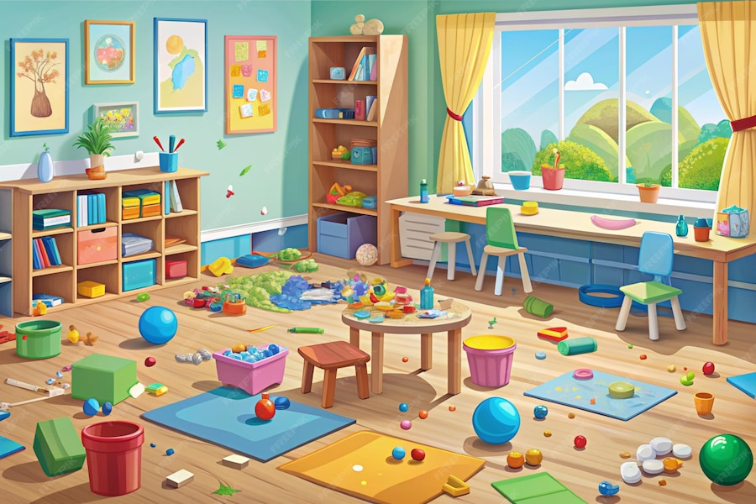
Tell me some sentences containing prepositions about this room
.

Slide 5
Locate the preposition in the sentence below.
He sat between his friends.
They arrived before lunchtime.
The ball rolled into the garden.
The dog hid behind the sofa.
We stayed inside during the storm.
She ran towards the park.

Slide 6
Insert a suitable preposition in the sentences below.
The children played _____ the park after school.
He left his bag __________ the desk.
We walked ___________ the forest on our trip.
The picture hung ________the fireplace.
She placed the cup ___________the plate

Slide 7
Questions
Which word is the preposition in this sentence?
The cat slept under the chair.
A) cat
B) slept
C) under
D) chair

Slide 8
Questions
2. Which sentence contains a preposition?
A) She quickly ran.
B) He jumped over the fence.
C) They laughed loudly.
D) I sang a song.

Slide 9
Questions
Identify the preposition in the sentence below.
The keys are on the table.

Slide 10
Questions
Insert a suitable preposition in the sentence below.
She sat __________ her friend during lunch.

Slide 11
Questions
Which word is NOT a preposition?
A) before
B) under
C) quickly
D) between

Slide 12
Independent task
Stick the sheet in
Complete it
Get it marked
Move onto practise SATS questions

