Slide 1
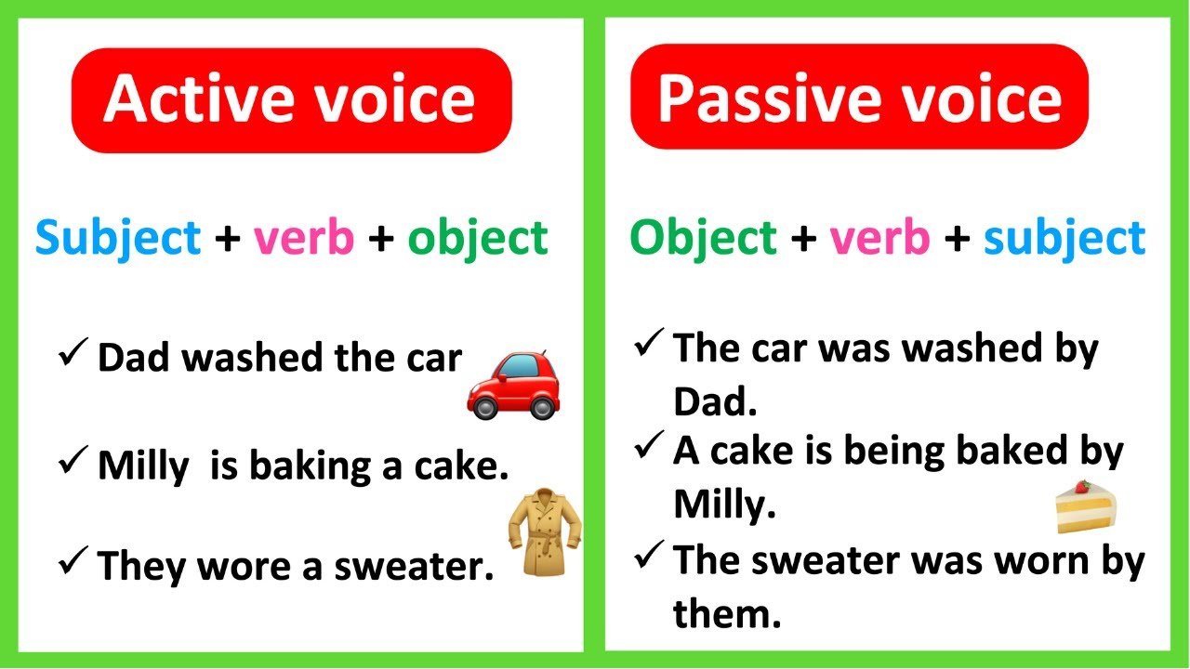
Active or Passive Voice

Slide 2

Active voice
Active voice is when the subject performs the action.
The sentences follow this pattern
Subject → verb → object
The cat chases the mouse.
The cat is doing the chasing, so it is the subject.
Chases is the verb
The mouse is being chased, so it is impacted, so it is the object.

Slide 3
Identify the subject, object and the verb in the sentences below.
The dog chased the ball.
Sophie wrote the letter.
The storm damaged the roof.
Jack kicked the ball.
The chef cooked the meal.

Slide 4

Passive voice
Passive voice is when the subject receives the action.
The sentences follow this pattern
Object → verb → subject
The mouse was chased by the cat.
The mouse is being chased, so it is impacted, so it is the object.
Chases is the verb
The cat is doing the chasing, so it is the subject.
BY ZOMBIES

Slide 5
Identify the subject, object and the verb in the sentences below.
The ball was chased by the dog.
The letter was written by Sophie.
The roof was damaged by the storm.
The ball was kicked by Jack.
The meal was cooked by the chef.

Slide 6
Look at the sentences below. Identify if they are written in the active or passive voice.
The animals were fed by the farmer.
The police caught the thief.
The leaves were blown away by the wind.
The artist painted a portrait.

Slide 7
Change these sentences from active to passive
The team won the match.
The builder repaired the wall.
The girl opened the present.

Slide 8
Change these sentences from passive to active
The zebra was chased by the lion.
The lesson is explained by the teacher.
The car was stolen.

Slide 9
Questions
Identify the sentence written in the passive voice.
The children played in the park.
B) The park was played in by the children.
C) The children are playing in the park.
D) The children will play in the park.

Slide 10
Questions
Identify the sentence written in the active voice.
The cake was eaten by Tom.
The cake is being eaten.
Tom ate the cake.
The cake has been eaten.

Slide 11
Questions
Rewrite the sentence in the active voice.
The letters were delivered by the postman.

Slide 12
Questions
Rewrite the sentence in the passive voice.
The choir sang the song.

Slide 13
Independent task
Stick the sheet in
Complete it
Get it marked
Move onto practise SATS questions

