Slide 1
Percentages
Top TIP – Use your I KNOW box

Slide 2
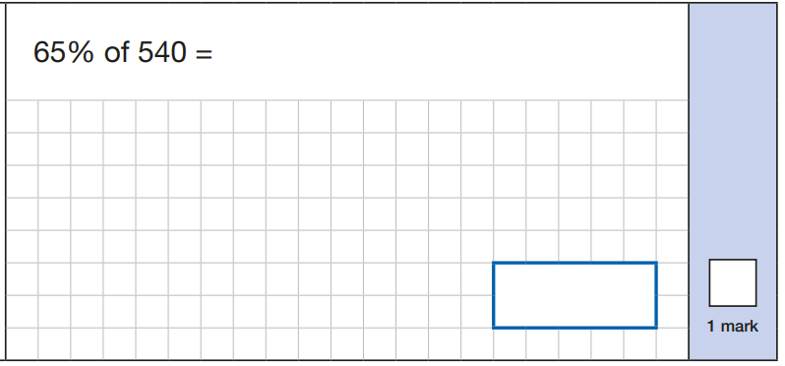
Create your I KNOW box

Slide 3
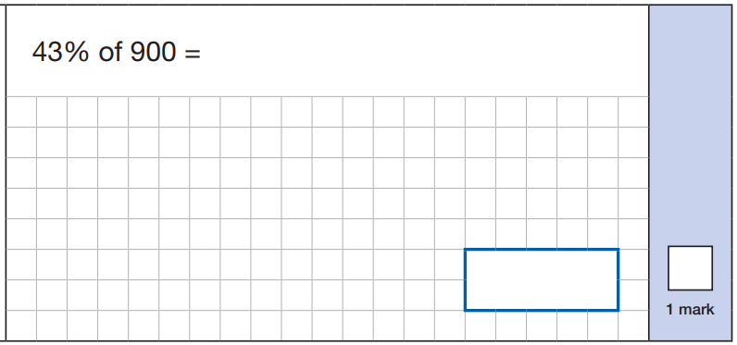
Create your I KNOW box

Slide 4
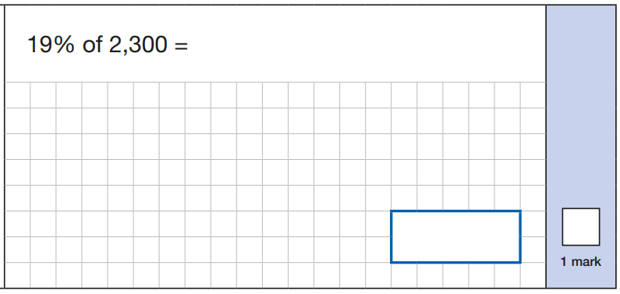
Create your I KNOW box

Slide 5
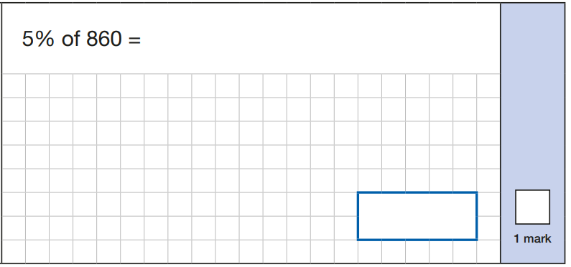
Create your I KNOW box

Slide 6
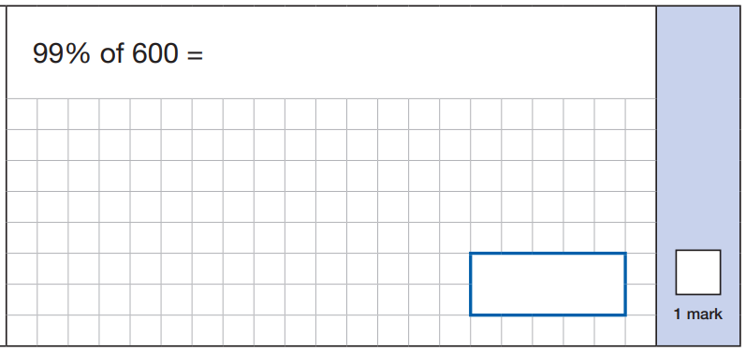
Create your I KNOW box

