Slide 1
Reasoning – Mass

Slide 2
Remember our key measure facts
100cm = 1m
10mm = 1cm
1000m = 1km
1000g = 1kg
1000ml = 1L
Which one is to do with mass?

Slide 3
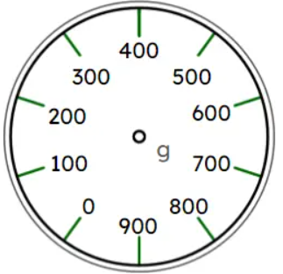
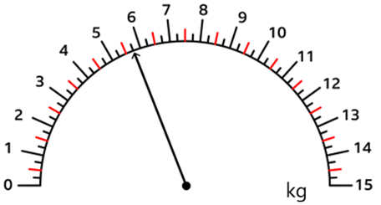
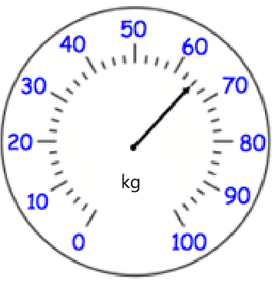
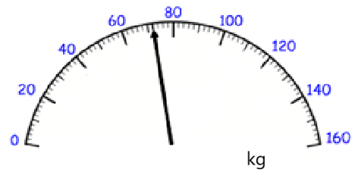
What is the scale going up in?

Slide 4
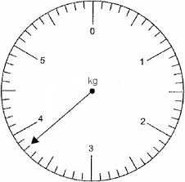
Sam is baking a cake.
When he has mixed all the
ingredients, it weighs the amount
on the scale.
He used 1500g of flour and 750g of sugar.
How much butter did he use?

Slide 5
James, Vicky and Albie are going on holiday.
Their luggage must total 27kg. They have 3 cases.
James’ suitcase weighs 12.45kg.
Vicky’s suitcase weighs 10670g.
How much does Albie’s case weigh?

