Slide 1

Maths at Springwood

Slide 2
Maths at Springwood
At Springwood Federation, we believe that a high-quality mathematics education is essential for developing pupils’ confidence, curiosity, and competence in mathematics. Our intent is to nurture a deep understanding of mathematical concepts through a curriculum that is coherent, sequential, and accessible to all pupils, including those with SEND and disadvantaged backgrounds.
We aim to develop pupils who:
Understand and apply mathematical concepts fluently and confidently.
Can reason mathematically, solve problems, and think critically.
Communicate their mathematical thinking clearly using precise vocabulary.
Develop resilience and a growth mindset towards challenges in mathematics.
Appreciate the relevance of mathematics in everyday life and future learning.

Slide 3
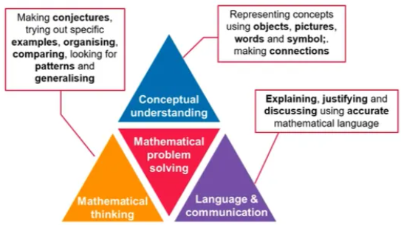
Ark Maths Mastery
At Springwood, we follow Mathematics Mastery by Ark Academy.
This scheme has been shown to give on average two months additional progress for pupils for the first year and then three months additional progress for pupils as they are exposed to this for longer.
Mathematics mastery follows
three dimensions of depth
to enable pupils to effectively problem solve.

Slide 4
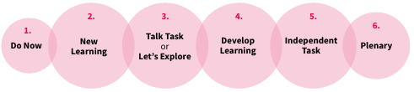
Every maths lesson at Springwood
Every lesson from year 1 to year 6, follows the following structure:

Slide 5
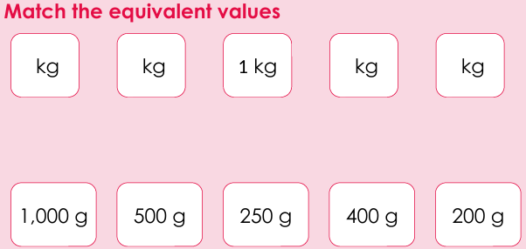
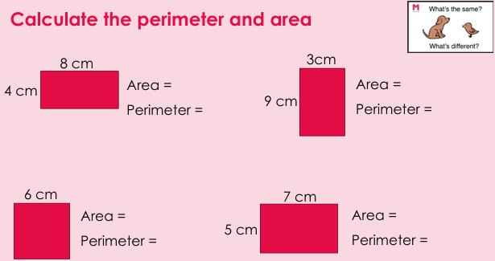
Do Now
A retrieval task designed to revise a previously taught concept that will be built upon in this lesson. It is a task that should take 2/3 minutes to warm up pupils’ brains and be ready to make connections to previously taught concepts.

Slide 6
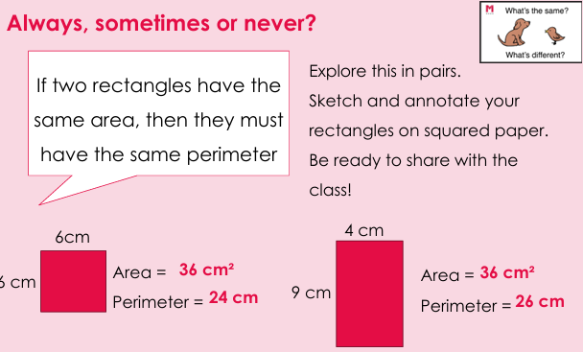
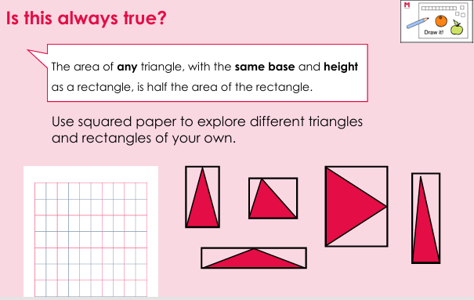
New Learning
An explicit teach from the class teacher about the new topic. A teacher will actively model and think aloud what they are doing so the pupils can see the mathematical thinking.

Slide 7
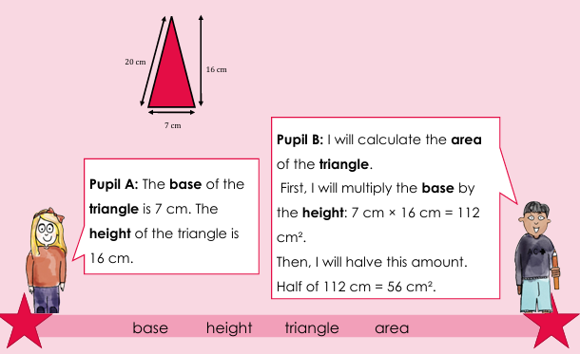
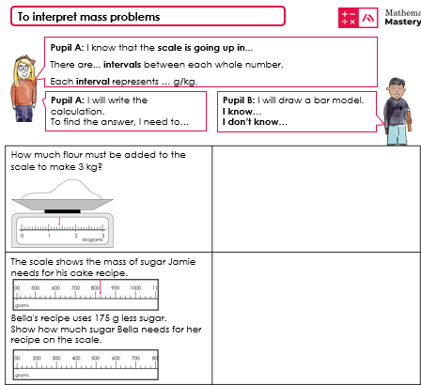
Talk Task or Let’s Explore
This section provides an opportunity for pupils to talk about their learning with a partner in full sentences applying specifically taught vocabulary.

Slide 8
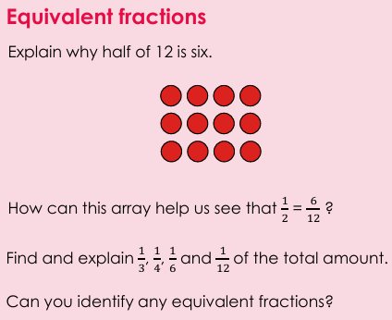
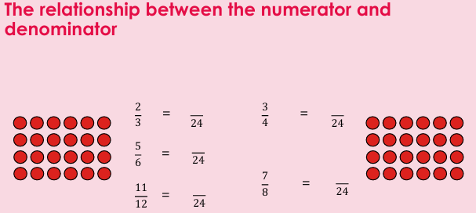
Develop learning
This section is a further teach from the class teacher moving the new learning forward to make further connections or challenge deeper thinking.

Slide 9
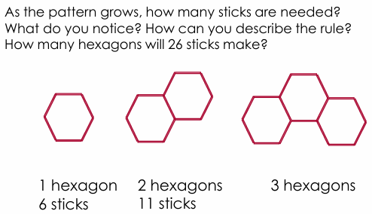
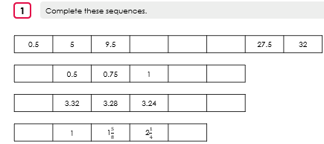
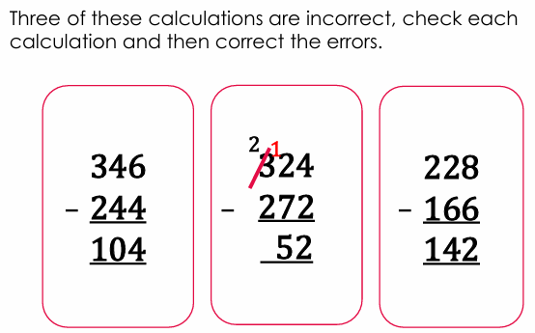
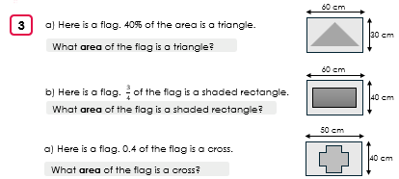
Independent task
This is time for pupils to apply the new learning to different styles of questions.

Slide 10
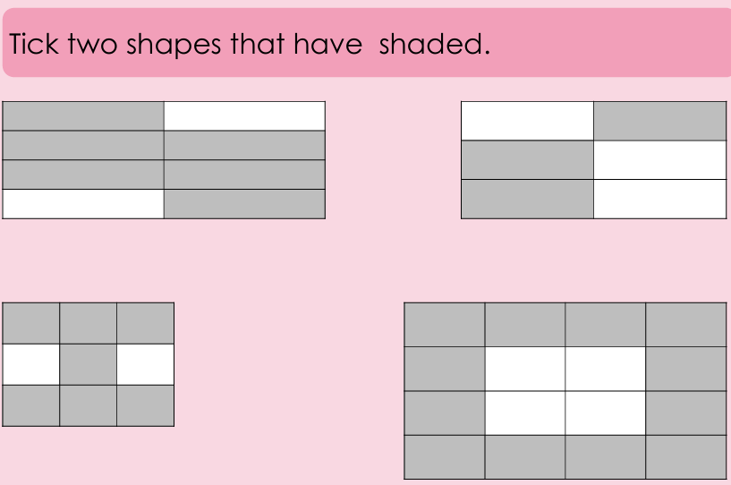
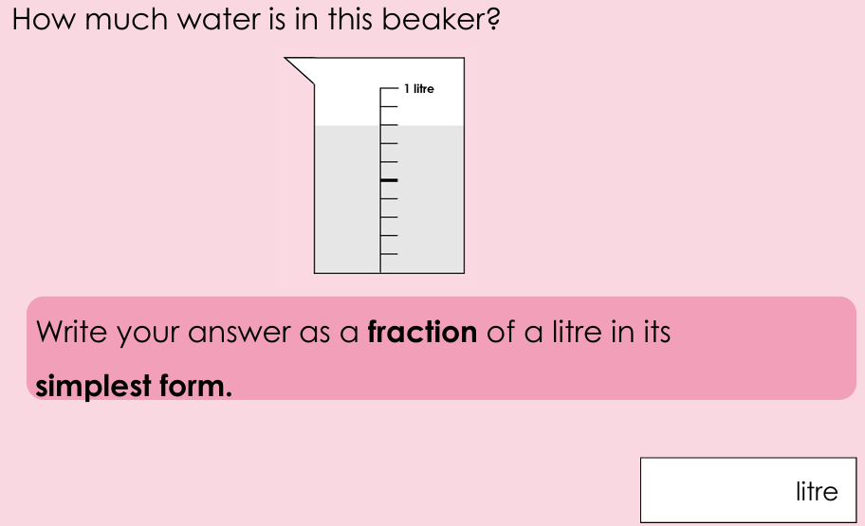
Plenary
Plenaries provide pupils to check their understanding in a problem format similar to assessment style questions.

Slide 11
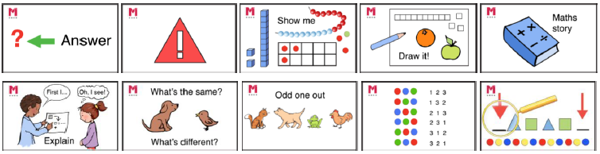
Ideas for depth
To challenge pupils, we use ideas for depth:
- Odd one out: different answers, regrouping and different strategies
Maths story – create their own real-life math story
Show me / Draw me – use a manipulative or pictoral representation as proof
Errors – identify incorrect working, incorrect grouping, incorrect method
Answer – pupils given the answer and they create the problem or calculation

Slide 12
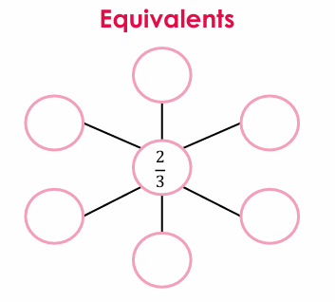

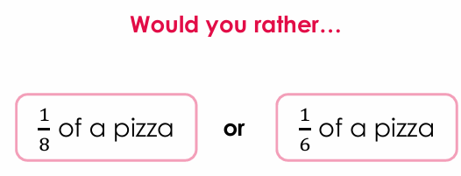
Maths meetings
These are vital sessions that allow pupils to consolidate key areas of maths.
They are typically 10 – 15 minutes
They cover several curricular areas allowing pupils to recall knowledge and build on their mastery of it.
They incorporate songs, rhymes, chants and active participation.
It is also an opportunity to overlearn times tables and practise arithmetic skills.

Slide 13
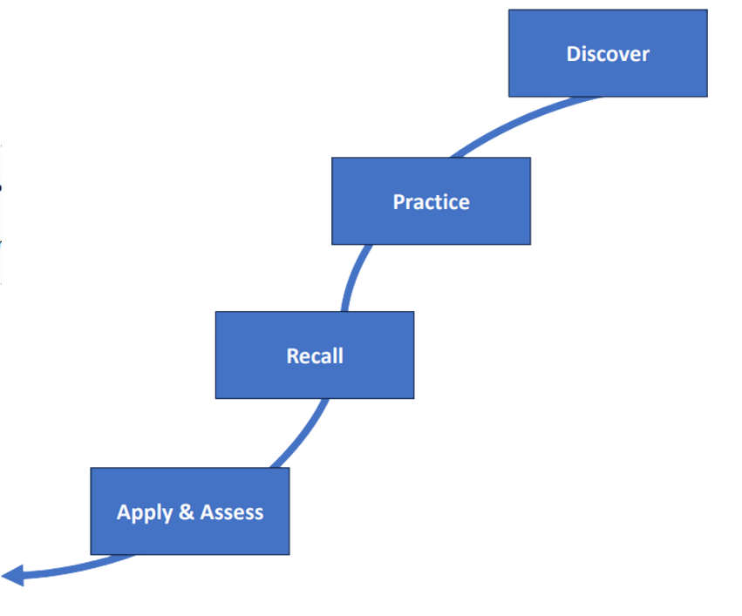
Key facts taught at Springwood
At the start of every half term, key facts are explicitly taught following
the discover, practise, recall, apply and assess methodology.
Year 1 – x 10, x2
Year 2 – recap x10 and x2, x5, x3
Year 3 – recap Year 2, x4, x 8, x6
Year 4 – recap Year 3, x 11, x12, x7, x9
Year 5 and Year 6 practise arithmetic skills including learning equivalent fractions, decimals and percentage facts.

Slide 14
Ways to solve problems
When solving calculations and worded problems, we teach children a range of strategies them as we like them to become efficient and aware of which strategy works best for them.
Rounding and adjusting
Number lines
Use a times table fact or number bond
Place value grids
Formal methods
Converting between fractions, decimals and percentages

Slide 15
Summative assessments at Springwood
At Springwood, we access pupils at the end of each term. It allows teachers to:
Track and present progress to parents
Inform future teaching
Support transitions
Give pupils the opportunity to show what they know independently
Exam style practise.
We use the summative assessments from Mathematics Mastery and previous SATS papers for Year 6.

Slide 16
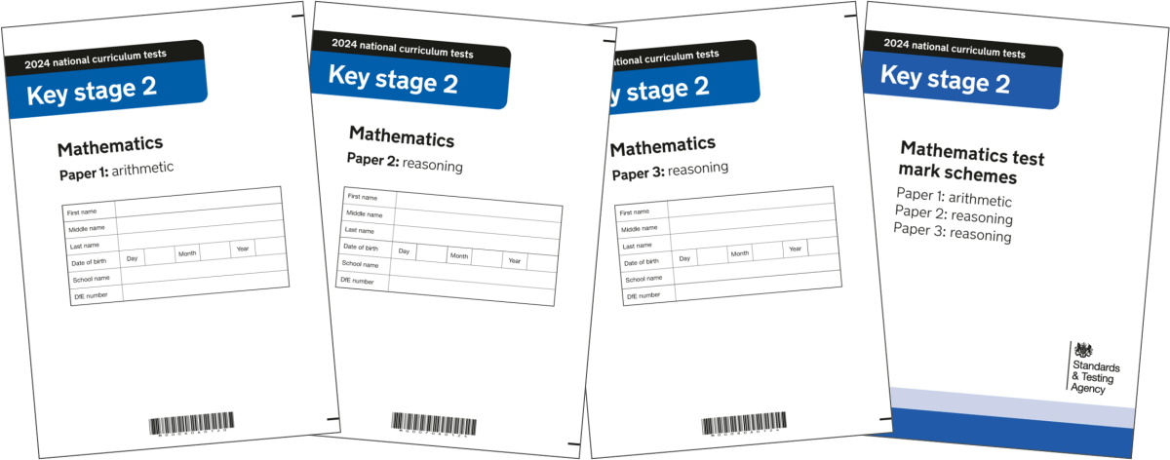
National assessments
At Springwood, we follow the national assessments for year 4 and year 6.
Year 4 – Multiplication Tables check (MTC)
Pupils have 25 multiplication questions to solve. They have six seconds to answer. This is in June. There is no pass or fail.
Year 6 – SATS
Pupils sit three papers. An arithmetic paper that is purely calculation based and two reasoning questions that contain mostly worded problems. These assessments are timed and this takes place in May. The pass mark changes each year.

Slide 17



How can you help at home?
It is vital that pupils learn their key facts and times tables to support fluency and problem solving.
We use Numbots and Times Table Rock Stars to practise at home.
To support year 4, we recommend using UR.Brainy to practise for their multiplication check.

Slide 18
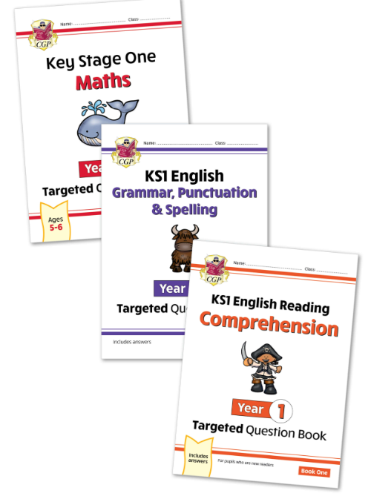
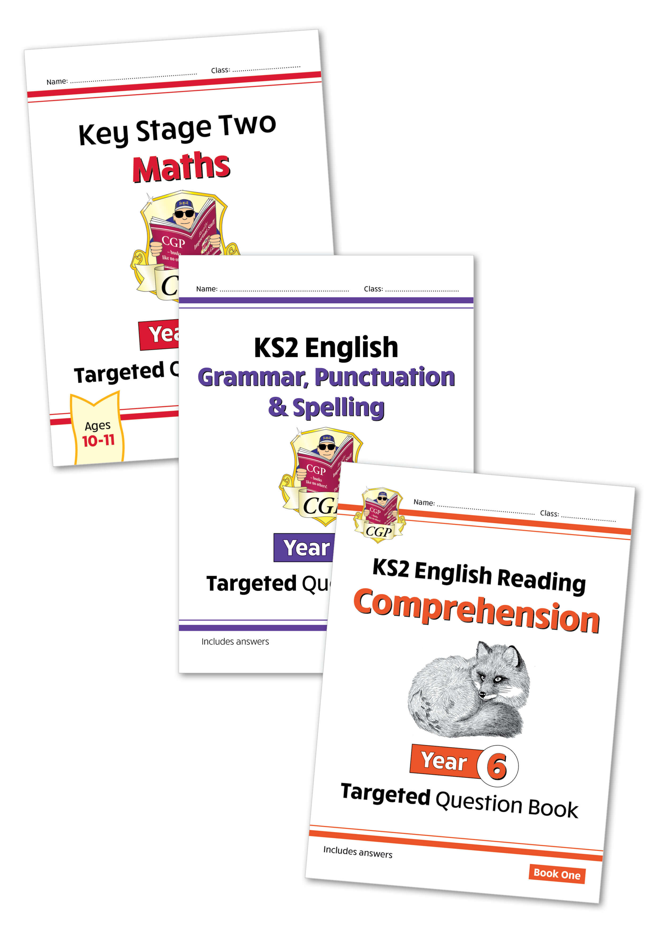
CGP targeted books to support at home
If you wish, you can order a bundle of recommended targeted support guides at home.
Each pack contains:
Reading comprehension
Grammar, punctuation and spelling
Maths
If you order through the school, the bundles are cheaper.
KS1 = instead of £15.45 : Springwood £6.60
KS2 = instead of £15.65 : Springwood £7.75
Bundles from year 1 - 6

Slide 19
Any questions?

