Slide 1

Year 6 expectations
What to expect in Year 6, including SATS, and how to support your child’s learning.

Slide 2
What to expect in Year 6
Increasing independence in all subjects
Developing prior knowledge from year 5 and developing these skills further.
This stage marks the end of Key Stage 2 and the transition to secondary school in September.
SATS

Slide 3
SATS
SATS week begins Monday 10th May 2027
Monday 10th May – Grammar, punctuation and spelling papers
Tuesday 11th May – Reading paper
Wednesday 12th May – Maths Arithmetic paper 1 and Maths Reasoning paper 2
Thursday 13th May – Maths Reasoning paper 3

Slide 4


What will my child do in Year 6?
Reading
In reading, children read a wider range of texts varying in structure, genre and style.
Children will read for a longer amount of time to build up their reading stamina.
Children will develop their opinions and responses towards texts using evidence to justify their reasoning.
Children will compare a wider range of texts from the same author, same genre or theme
Children will be given a range of comprehension style questions to check understanding.
Things you can do to help at home:
Ensure your child is reading an age and stage appropriate text
Listen to them read aloud ensuring correct volume, pace, intonation and tone
Ask questions about what they have read
Make comparisons between books and films/programmes, if there are any
Give them opportunities to read – the TV guide, a letter, the news (where appropriate)
Oxford owl website has some free ebooks for pupils, SORA (free online library)

Slide 5

Reading SATS paper
Pupils have 60 minutes to read 3 texts and answer the questions..
The text can vary from one page to three pages in length.
These texts could be a non-fiction piece, a leaflet, a poster, a narrative or a poem.
Pupils then have between 10 – 15 questions to answer about each text.
The questions vary from 1 mark select and retrieve questions to 3-mark inference style questions.
We advise pupils where appropriate to read the questions first and then read the text to find the answer.

Slide 6
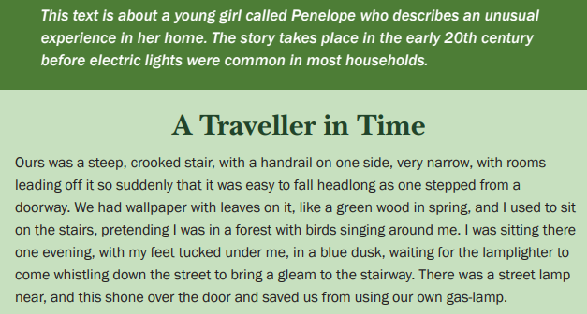



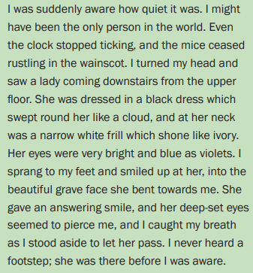
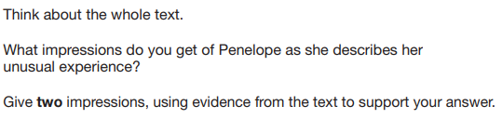
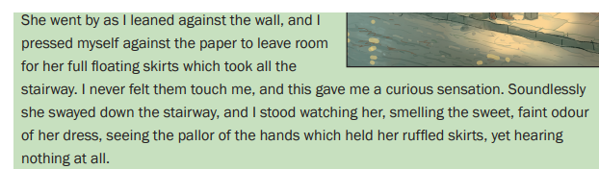

Slide 7


What will my child do in Year 6?
Writing
In writing, children will continue to write in a range of styles and for different purposes including looking at settings, character descriptions, narratives, journalistic recounts and poetry.
Children will write for a longer amount of time to build up their writing stamina.
Children will increasingly and independently select their formality, considering the impact their word choice and sentence choice has on the reader.
Children will develop their understanding of punctuation and will select this on purpose.
Children will be able to explain their grammatical choices using the correct grammatical terms.
Children should be confident with the year 3/4 spelling words and be mostly confident with the year 5/6 spelling words
Things you can do to help at home:
Practise spelling the year 5 and 6 words
Give opportunities for writing – the shopping list, send a letter to a family member
When looking at a piece of writing, ask the name of the punctuation why it is used and what purpose does it have.

Slide 8
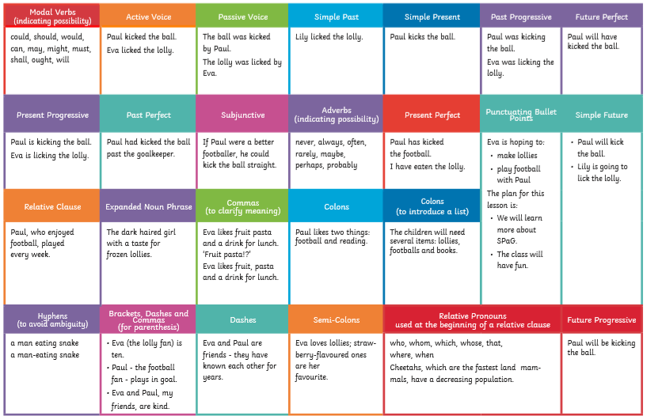
Grammar and punctuation in year 6

Slide 9
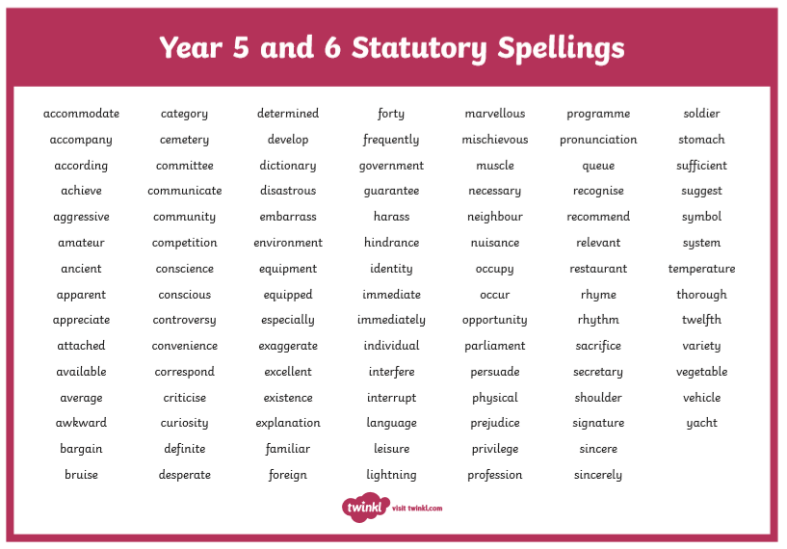
Year 5 and 6 spelling list

Slide 10
Grammar, Spelling and punctuation SATS paper
Pupils have two tests.
First test is 50 questions about grammar: insert the full stop, insert the semi colon, tick the question or rewrite the sentence.
The test is 45 minutes long.
These questions are often circle, underline, insert, match or rewrite the word or sentence.
Then pupils have a spelling test.
Pupils are tested on 20 words that will contain a spelling rule or pattern they have learnt from their primary school years.
Pupils are given the words in a sentence context to support their understanding.
Pupils have as long as they need to complete the test.
Pupils are encouraged to write it out multiple times to check it looks correct and the rule has been followed.

Slide 11
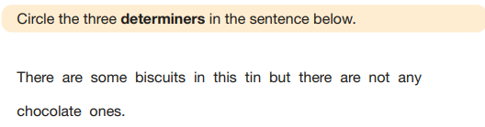

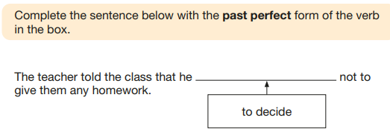
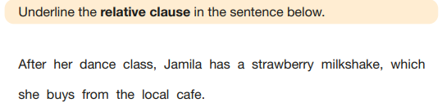
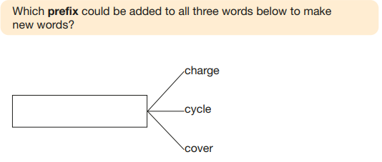
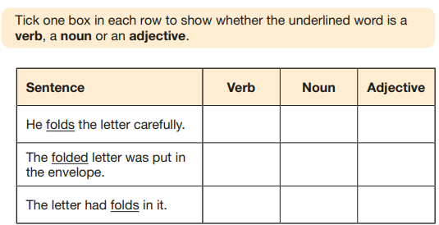

Slide 12
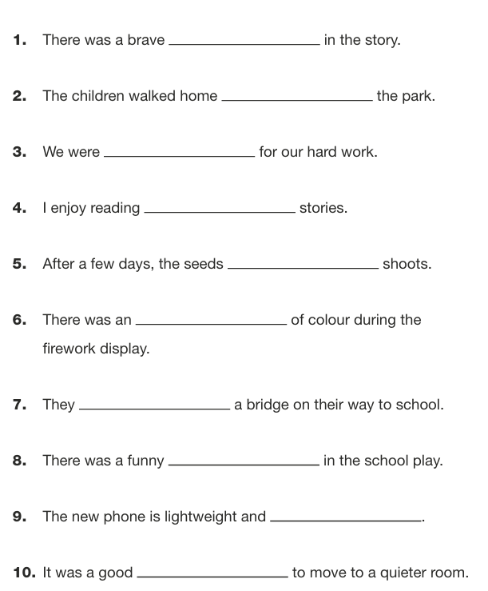
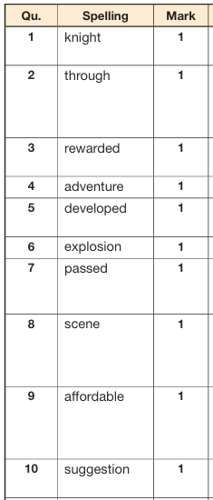

Slide 13
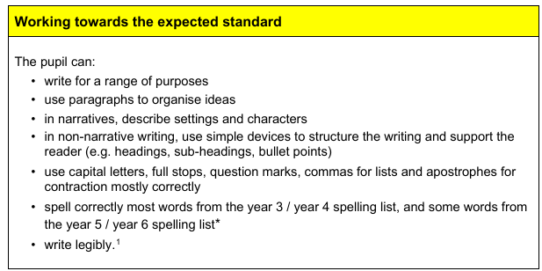
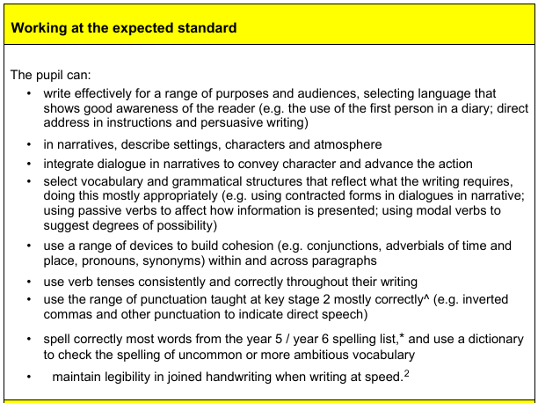
Writing assessment
There is no writing SATS paper.
Pupils will write a range of pieces in their writing lessons independently.
Teachers will then assess these at the end of the year against the writing framework.

Slide 14

What will my child do in Year 6?
Maths
In maths, children will continue to use the four operations with numbers up to a million and understand place value up to ten million
Children will independently begin to select the most efficient and appropriate method to solve calculations and word problems: mental, jottings, formal written methods
Convert fluently between fractions, percentages and decimals to support calculating efficiently with these at speed.
Convert and calculate with different units of measure including perimeter, area, volume, mass and capacity.
Complete multi step problems over multiple strands of the maths curriculum
Things you can do to help at home:
Times table rockstars to increase fluency – especially with the division
Practise converting between decimals, fractions and percentages to become fluent

Slide 15
Maths SATS papers
Pupils have three tests.
Test 1 – arithmetic
Children have to answer 36 questions that are purely calculation based in 30 minutes. There are no word problems.
Test 2 and 3 – reasoning papers
Children have two papers that have around 23 questions to solve in each.
Each test is 40 minutes.
These test the other parts of the maths curriculum - word problems, shape, measure and fractions.
Children have to find the maths within the problems.

Slide 16
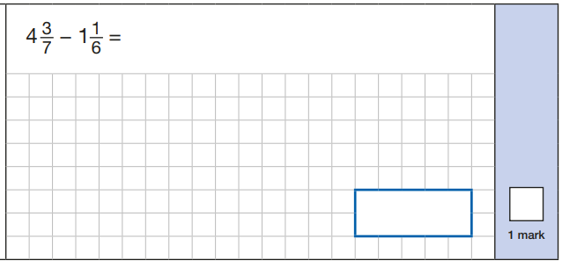
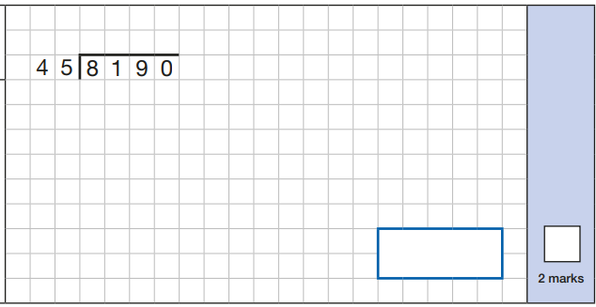


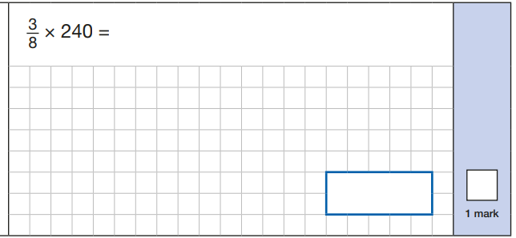

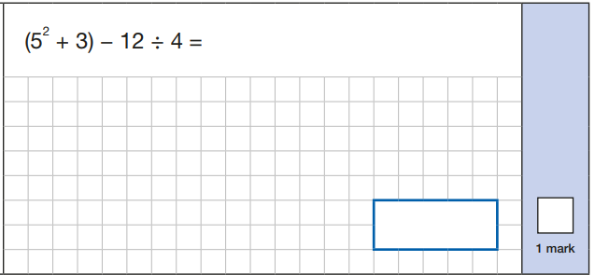

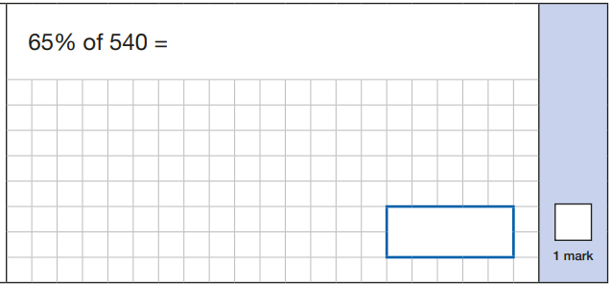
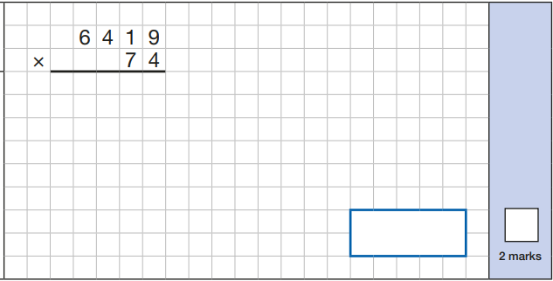

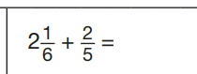

Slide 17
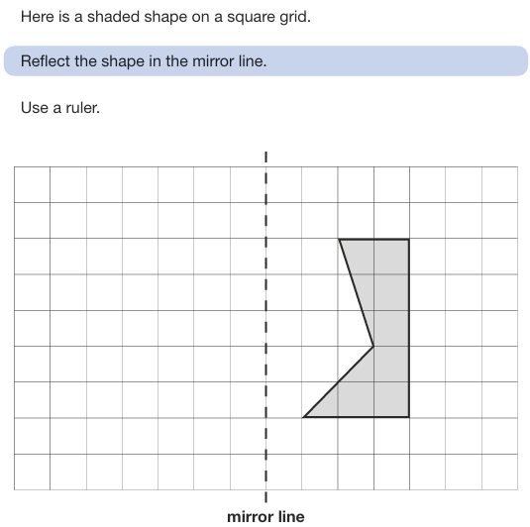
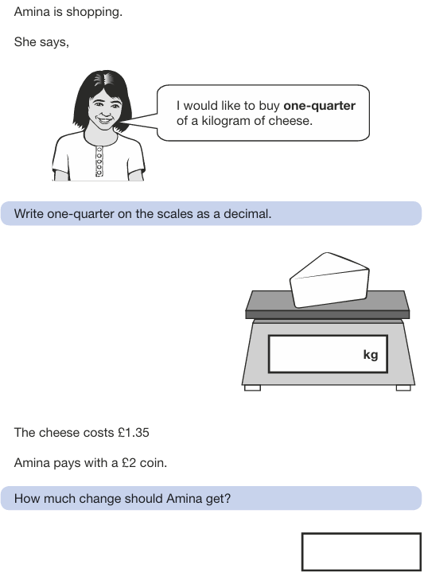
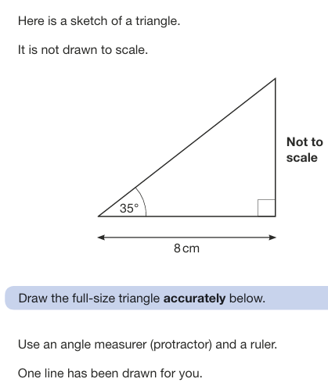
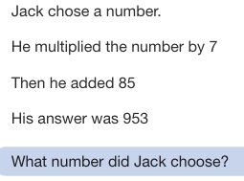
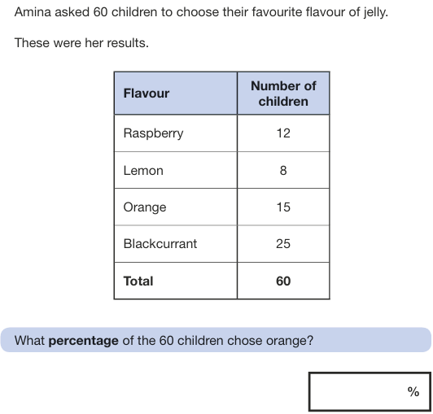
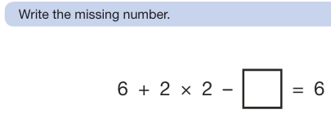

Slide 18
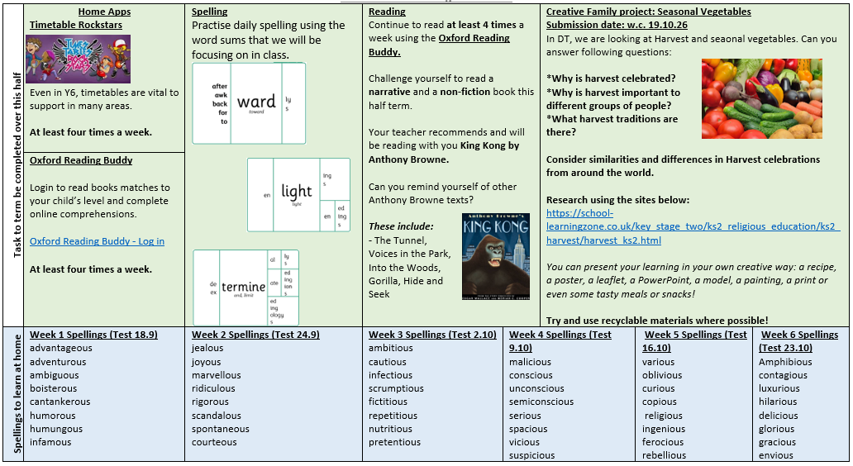
Home Learning
School Home Learning:
Reading
Spellings
Creative project
Additional Year 6 Home Learning from after October half-term
1 piece of Reading, 1 piece of GPS, 1 piece of Maths. Children need to complete two out of the three to earn extra play.
There will be support for 6M on Wednesdays and Fridays and for 6J on Tuesdays and Thursdays.
Children will also have the opportunity to complete extra TTRS and Oxford Reading Buddy on those days.

Slide 19
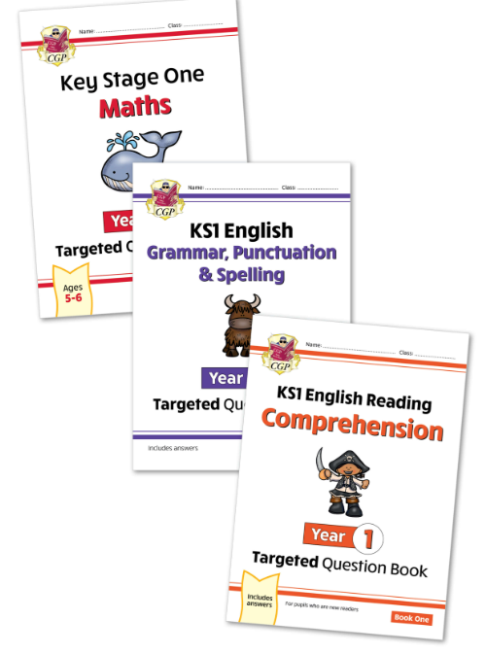
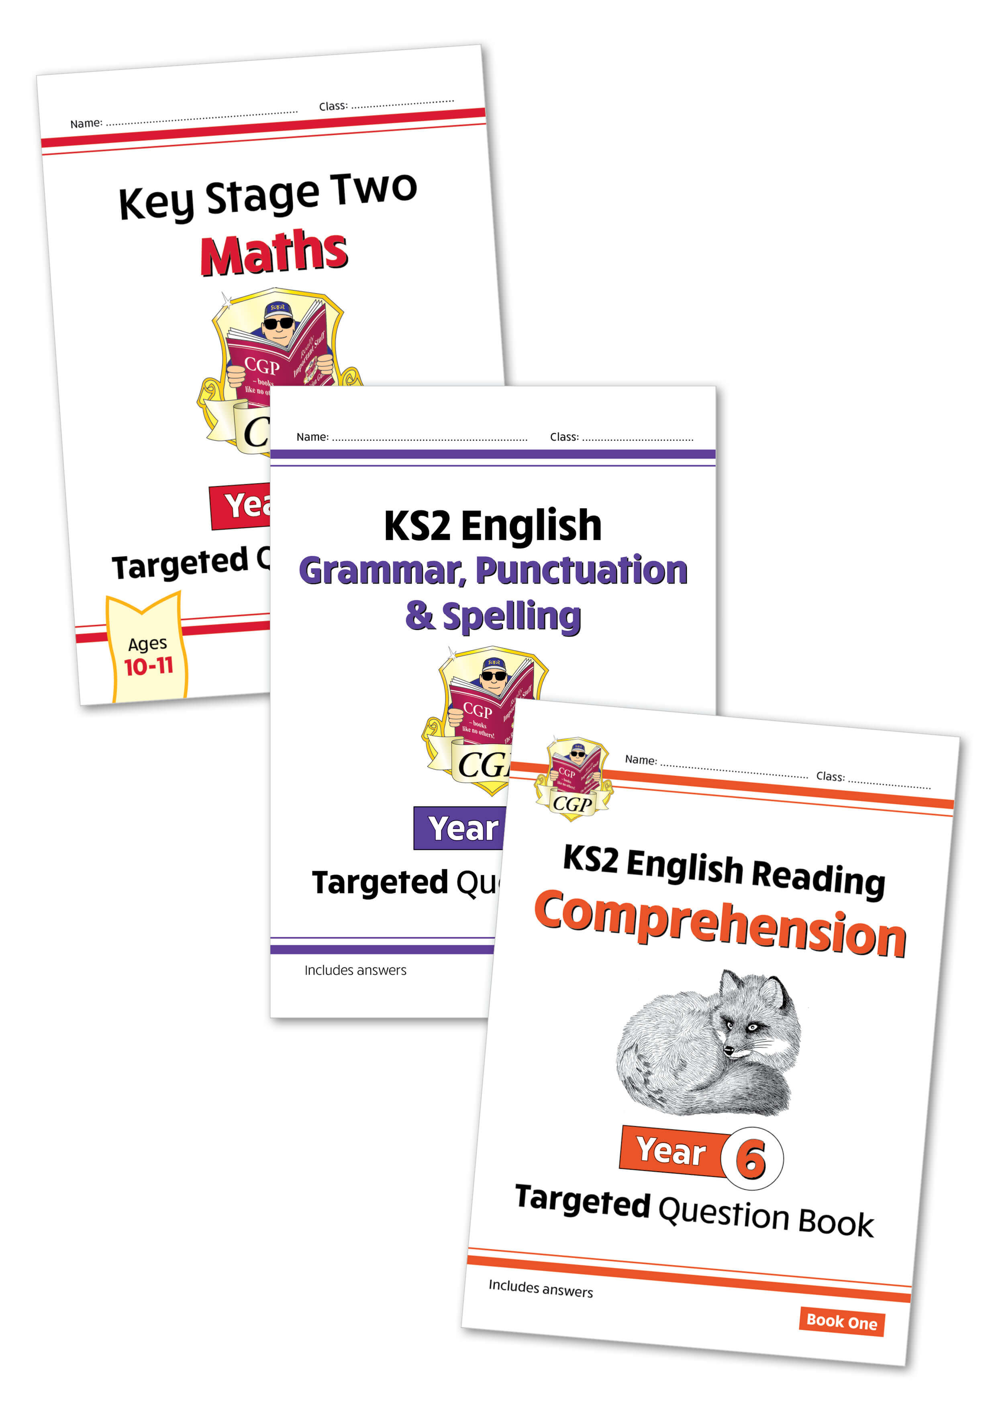
CGP targeted books to support at home
If you wish, you can order a bundle of recommended targeted support guides at home.
Each pack contains:
Reading comprehension
Grammar, punctuation and spelling
Maths
We will offer an arithmetic add on for year 6.
If you order through the school, the bundles are cheaper.
KS2 = instead of £15.65 : Springwood £7.75
Bundles from year 1 - 6

Slide 20
Any questions

